Slide 1
Thermodynamic and kinetic characteristics
Fyodor Malchik

Slide 2
Thermodynamics and Kinetics of Adsorption
subtitle:
What can we learn about adsorption systems from thermodynamic and kinetic measurements?
IMPRS-Lecture Series 2012: ‘Experimental and Theoretical Methods in Surface Science’
Klaus Christmann
Institut für Chemie und Biochemie, Freie Universität Berlin
Organization
Introduction; terms and definitions
Thermodynamics of adsorption
Adsorption as a macroscopic (thermodynamic) phenomenon
Equilibrium thermodynamics and adsorption isotherms: Langmuir and BET isotherm
The adsorption energy: Initial adsorption energy and a-priori heterogeneity
Coverage dependence of the adsorption energy: lateral interactions and a-posteriori heterogeneity
Kinetics of adsorption and desorption
The rate of adsorption; trapping and sticking
The rate of desorption; order of desorption and frequency factor
The desorption energy: Binding states and lateral interactions
Experimental procedure and evaluation of TD spectra
Summary and conclusions

Slide 3
Technical applications of adsorption:
Separation processes of gaseous and liquid mixtures via molecular sieves
Heterogeneous catalysis
Chemical analyses (various types of chromatography)
Flotation processes
Gas mask filters
Lubrication phenomena
Optical coatings
corrosion-resistant coatings (Lotus effect)
As we will see later, one distinguishes
chemical adsorption (chemisorption) and
physical adsorption (physisorption),
depending of the strengths of the interaction between adsorbent and adsorptive.
While chemisorption is most essential for heterogeneous surface reactions, physisorption plays a major role during separation and enrichment processes at and near phase boundaries.

Slide 4
1. Terminology: Strength of interaction forces - physisorption and chemisorption
Interaction forces responsible for adsorptive bonds
Kind of interaction | Strength of interaction
van-der-Waals | Very weak (usually less than 50 kJ/mole)
ionic | Strong (Coulombic origin) > 100 kJ/mole
covalent | Strong (quantum-chemical origin) > 50 kJ/mole
metallic | Strong (quantum-chemical origin), E > 50 kJ/mole

Slide 5
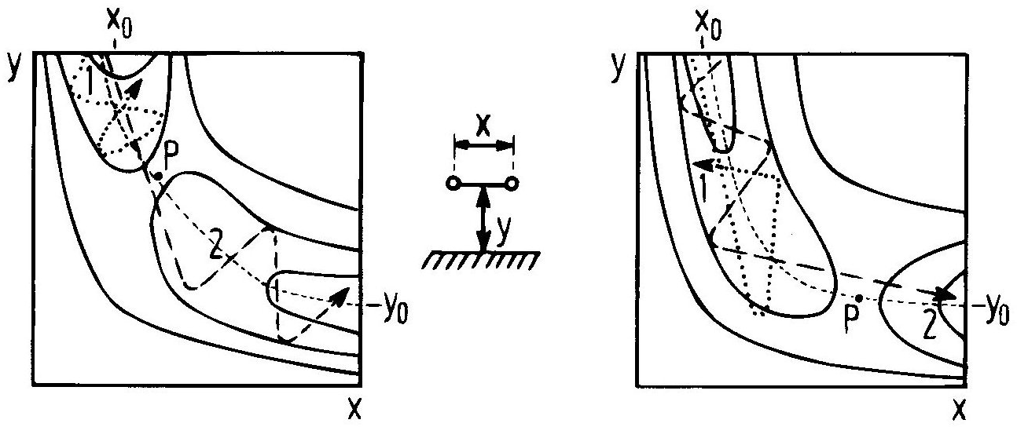
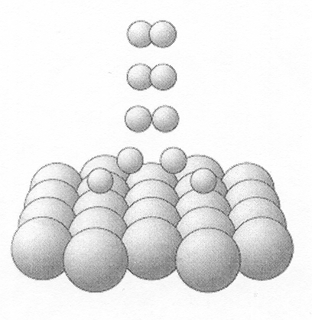
Terminology: associative and dissociative adsorption
The dissociation of a diatomic molecule can be better characterized by a two-dimensional potential energy representation. In these so-called elbow-plots the perpendicular distance of the molecule, y, is plotted against the internuclear distance, x. Whether or not the molecule can successfully dissociate depends on its translational and/or vibrational excitation.
early barrier
late barrier

Slide 6
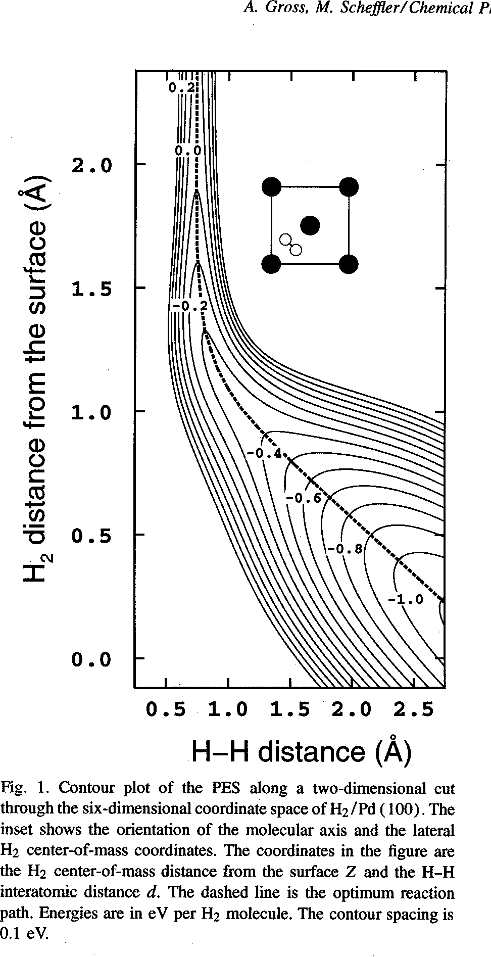
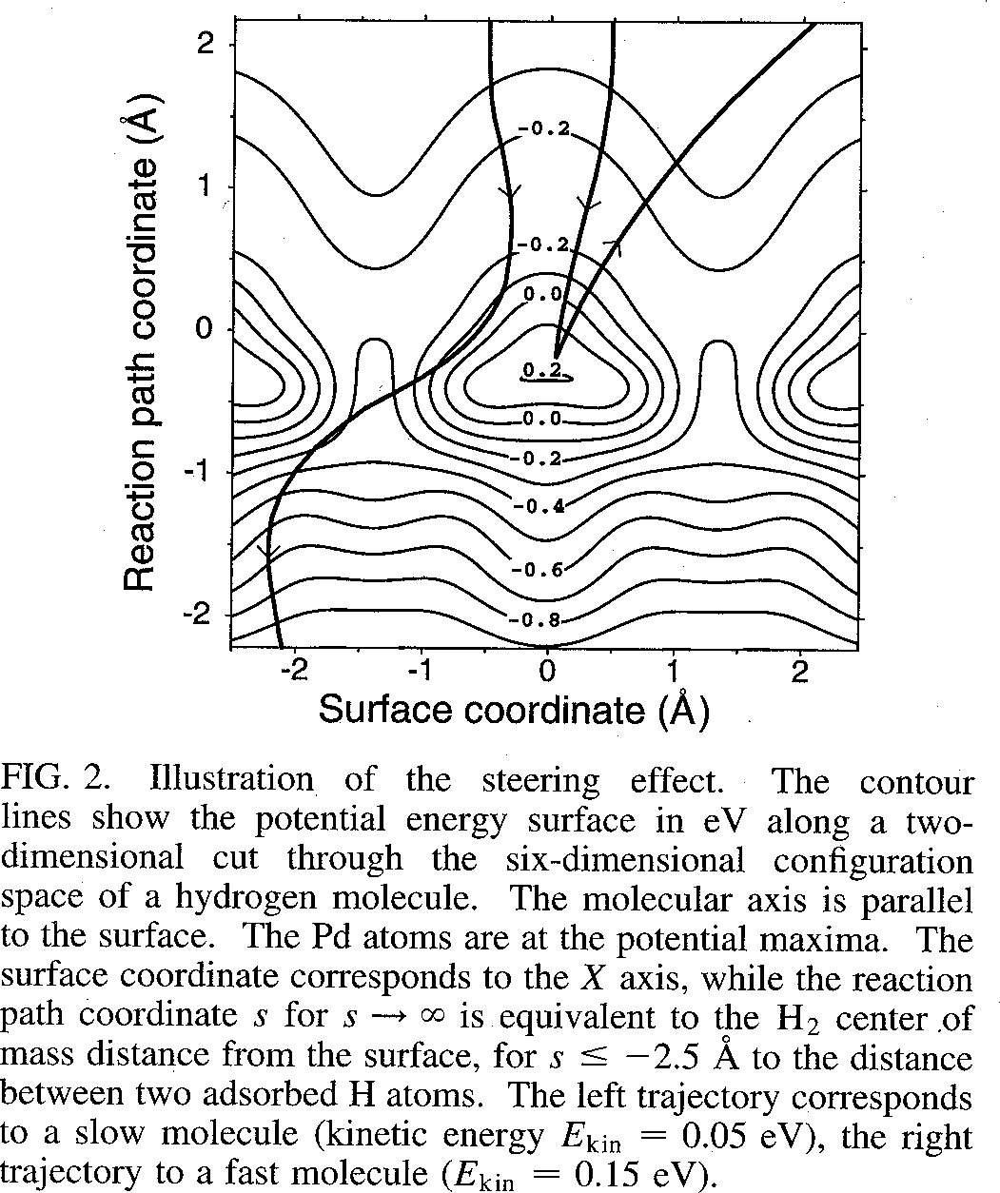
Terminology: associative and dissociative adsorption
The dissociation of molecular hydrogen has been studied theoretically in great detail, for example on Pd(100) surfaces by A. Groß et al.. Quite important is the so-called ‘dynamical steering’ where the H₂ molecule is guided to the optimum dissociation sites.

Slide 7
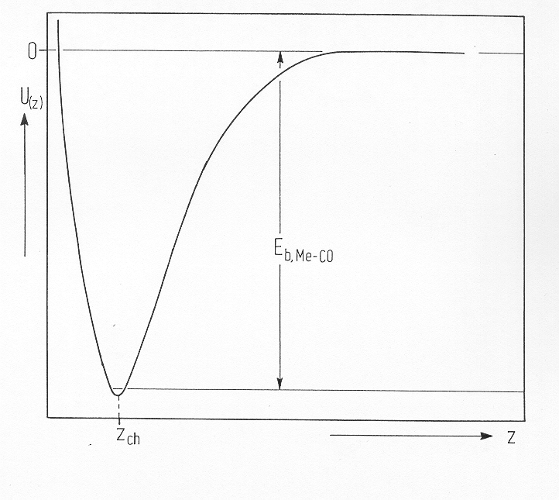
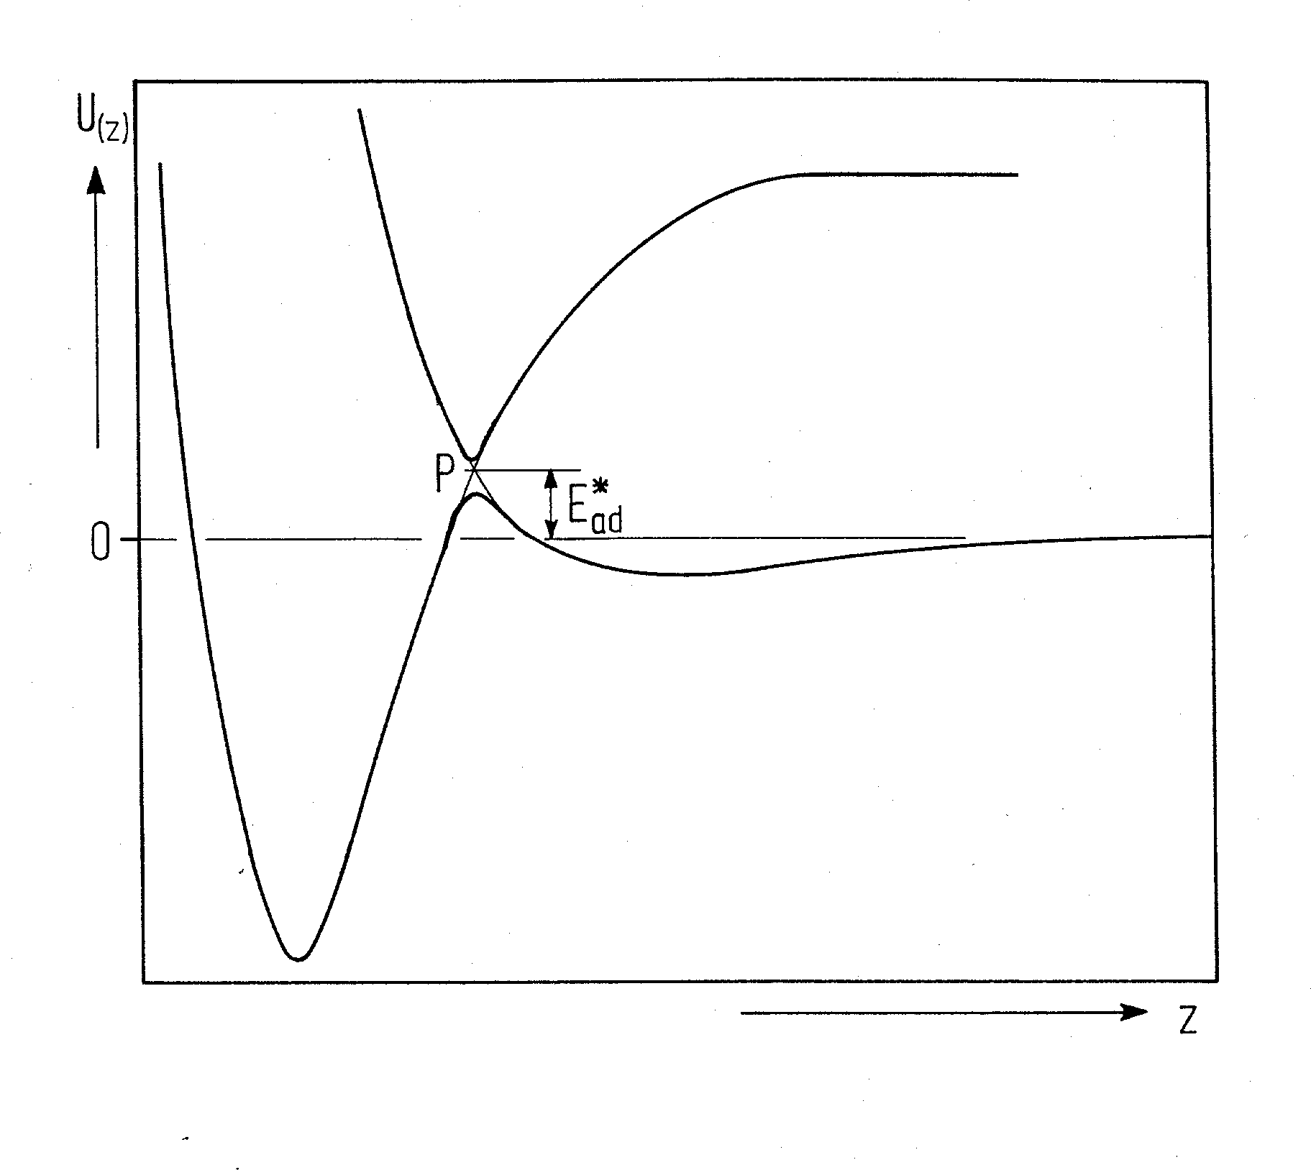
Terminology: activated and non-activated (spontaneous) adsorption
In the adsorbed state and in thermal equilibrium the trapped particle resides at the bottom of the potential well. It is either physically or chemically adsorbed on the solid.
In order to desorb it from the surface, one has to supply it thermally or electronically with the energy required to return to the gas phase. If activation barriers are involved, these have to be additionally overcome, and the desorbing particles then possess more energy than they had if they were in thermal equilibrium with the surface.
Non activated (spontaneous) adsorption: CO on Ni(111)
activated adsorption: hydrogen on a Cu(111) surface

